Slide 1
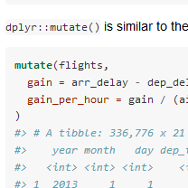


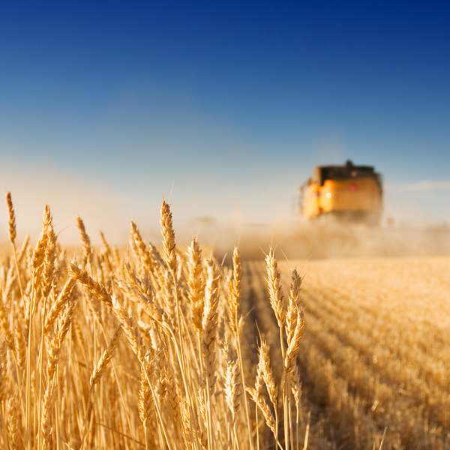
Efficient data.frame manipulation with dplyr and data.table
2019-04-15 Benjamin Brede

Slide 2
Overview
Background
Operation chaining
(Dis-)Advantages

Slide 3
Background - dplyr
Part of the TidyVerse, driven by Hadley Wickham (http://hadley.nz/) (RStudio)
Common interface to table backends:
data.frames (memory)
SQLite DBs (via dbplyr and RSQLite)
Spark (Sparklyr)
Functionality in verbs: mutate, select, filter etc.
Piping makes code more readable (via magrittr package)

Slide 4
Experiences – dplyr
Compact code & good overview
Generally fast operations (much code in C++ in background) (if you avoid unnecessary complex queries)
Would even say: if task can be solved with dplyr::group_by prefer over apply

Slide 5
Experiences – dplyr
Name clashes with other packages: select, filter
Irregularities for interfaces (e.g. SQLite), listed by John Mount (WinVector):
dplyr inferno (predicting expression values) https://github.com/WinVector/Examples/blob/master/dplyr/dplyrQuiz.md
Number of records in external sources https://www.r-bloggers.com/it-is-needlessly-difficult-to-count-rows-using-dplyr/

Slide 6
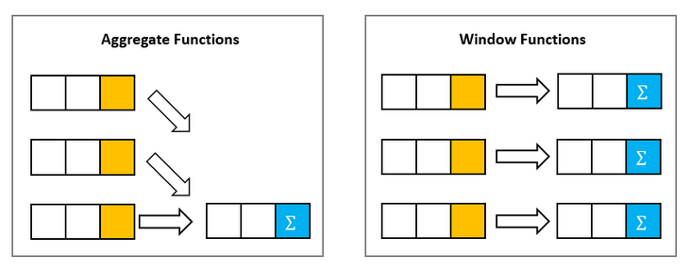
Experiences – dplyr
For the code later:
http://www.sqlitetutorial.net/sqlite-window-functions/

Slide 7
Background – data.table
Big data in R
Avoid copy/replace method for common R objects > data.tables are pointers (more similar to C)
Syntax leaning towards SQL

Slide 8
Experiences – data.table
Syntax more cryptic than dplyr, e.g.: data1[data2] > this is a join
Some features undocumented/hard to find, e.g. rolling joins https://www.r-bloggers.com/understanding-data-table-rolling-joins/

Slide 9
Resources
dplyr
overview: https://cran.r-project.org/web/packages/dplyr/
Introduction: https://cran.r-project.org/web/packages/dplyr/vignettes/dplyr.html
https://dplyr.tidyverse.org/
data.table:
Introduction: https://cran.r-project.org/web/packages/data.table/vignettes/datatable-intro.html
R and Big Data (2 day PE&RC course, in development)

